Slide 1
Mathematical Intuition
Presented by
TAUHEED khan
Msc data science

Slide 2
OUTLINE
Introduction of Naive Bayes Classifier
Conditional Probability
Bayes Theorem
Some Examples
Code Part

Slide 3
Naïve BAYES
Naïve- It’s called Naïve because it makes the assumption that all attributes are independent to each other. Such as if the fruit is identified on the bases of color, shape, and taste, then red, spherical, and sweet fruit is recognized as an apple.
Bayes – It’s called Bayes because it depends on the principle of “BAYES THEOREM”

Slide 4
Note
Before we dive deeper into this topic we need to understand what is “Conditional Probability” , what is “ Bayes Theorem” and how Conditional probability helps us in Bayes Theorem.

Slide 5
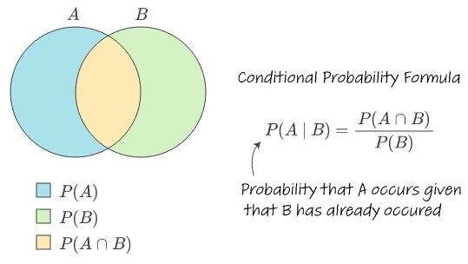
Conditional probability
Conditional probability is the probability of an event occurring given that another event has already occurred.

Slide 6
Examples
Q. In a batch, there are 80% C programmers, and 40% are Java and C programmers. What is the probability that a C programmer is also Java programmer?
Solution-
Let A → Event that a student is Java programmer B → Event that a student is C programmer P(A|B) = P(A ∩ B) / P(B) = (0.4) / (0.8) = 0.5 So there are 50% chances that student that knows C also knows Java.

Slide 7
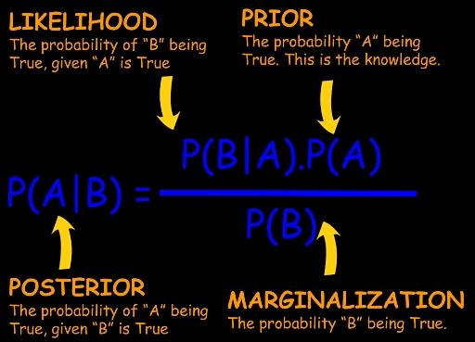
BAYE’S THEOREM
Bayes theorem predicts the occurrence of an event when another similar event has already taken place. Also, the occurrence of these two events is independent of each other.

Slide 8
Proof

Slide 9
Generalized formula

Slide 10
Example Q. Fruit= {'Yellow’,'Sweet’,'LonG’}
Fruit | Yellow | Sweet | Long | Total
Orange | 350 | 450 | 0 | 650
Banana | 400 | 300 | 350 | 400
Others | 50 | 100 | 50 | 150
Total | 800 | 850 | 400 | 1200

Slide 11
Solution
P(Yellow/orange) = P(Orange/Yellow)* P(yellow)/P(Orange)
= (300/800 * 800/1200)/(650/1200)
= 0.5
P(Sweet/Orange) = 0.69
P(Long/orange ) = 0
P(Fruit/Orange) = 0

Slide 12
P(Yellow / Banana ) = 1
P(Sweet/Banana) = 0.66
P(Long / Banana) =0.33
P(Fruit /Banana) = 0.65

Slide 13
(Yellow / Others) = 0.33
P(Sweet/Others) = 0.66
P(Long / Others) = 0.33
P(Fruit/Others) = 0.072
Fruit{'Yellow’,’Sweet’,'Long’} = Banana

Slide 14
THANK YOU

